Slide 1
JUSTIFI
Tech Stack Review
Mapping what we run, what it does, where it overlaps,
and where we can leverage or cut cost.
Prepared by Rise & Rooted Consulting
July 2026

Slide 2
PURPOSE
Why we mapped the stack
1
2
3
Visibility
Leverage
Cost control
One clear view of every tool the teams touch — what it does and who it serves.
Show each team where a tool can do more, and where I can help them use it better.
Surface overlaps so we can consolidate or renegotiate at renewal.
9 tools reviewed across go-to-market, support, and operations. This deck covers what each does, its cost, who it serves, its AI capability, and how they connect.
Rise & Rooted Consulting

Slide 3
SUMMARY · 1 OF 2
Prospecting, data & outbound
Tool | What it does | Category | Cost (list, 2026) | Facing | AI
Clay | GTM data enrichment + automation across 150+ sources; signal/intent tracking; triggers outbound plays. | Data enrichment | Launch $185 / Growth $495 per mo + usage | Internal | Yes — Claygent
Apollo.io | B2B contact/company database + email sequencing, dialer, deal management, CRM sync. | Prospect DB + engagement | $49 / $79 / $119 per seat/mo | Internal | Yes — AI email, insights
HeyReach | LinkedIn outreach automation at scale — multi-sender sequencing, unified inbox, multichannel. | LinkedIn outreach | $79/mo per sender (Growth) | Internal | Limited
LinkedIn Sales Nav | Advanced lead/account search, warm-intro paths (TeamLink), InMail, CRM sync. | Prospecting / intel | Core ~$99 / Advanced ~$149 per seat/mo | Internal | Some — AI insights
Source: Clay, Apollo, HeyReach, LinkedIn
Rise & Rooted Consulting

Slide 4
SUMMARY · 2 OF 2
CRM, support, docs & AI
Tool | What it does | Category | Cost (list, 2026) | Facing | AI
HubSpot | Core CRM + Marketing, Sales, Service, Content, Data hubs. System of record for the whole funnel. | CRM platform | Starter $20 / Pro ~$90-100 / Ent $150 per seat/mo | Both | Yes — Breeze AI
Zendesk | Customer support suite: ticketing, omnichannel, help center, AI auto-resolution. | Customer support | Suite Team $55 / Pro $115 per agent/mo | Customer | Yes — AI Agents
DocuSign | E-signature + agreement management. Contracts & order forms for signature; IAM adds AI workflows. | E-signature | Standard $25 / Business Pro $40 per user/mo | Customer | Yes — IAM AI
Notion | All-in-one workspace: docs, wikis, project/task management, meeting notes. | Knowledge / PM | Plus $10 / Business $20 per user/mo | Internal | Yes — Notion AI
Claude | General-purpose AI assistant for writing, analysis, research — the AI layer teams use directly. | AI assistant | Team Standard $25 / Premium $125 per seat/mo | Internal | Yes — it is the AI
Source: HubSpot, Zendesk, DocuSign, Notion, Claude
Rise & Rooted Consulting

Slide 5
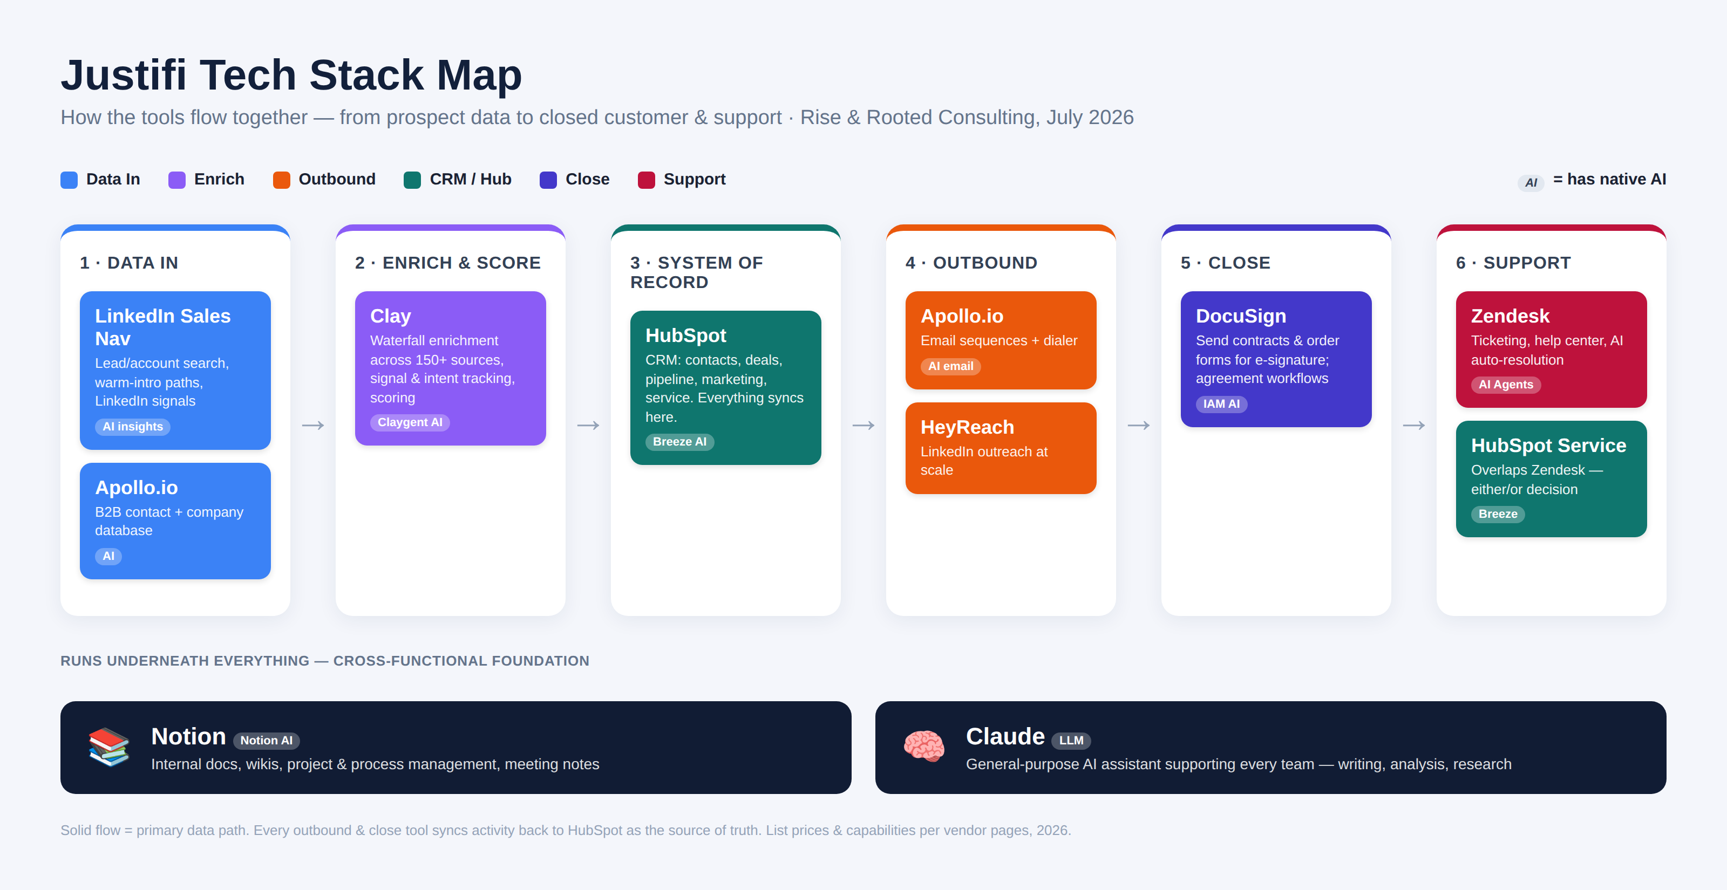
THE MAP
How the tools flow together
Rise & Rooted Consulting

Slide 6
ANALYSIS
Where the tools overlap
Prospecting & data
Outbound execution
CRM / source of truth
Clay · Apollo · Sales Nav
Apollo · HeyReach · HubSpot
HubSpot ← everything
Heaviest overlap. Clay sits above the others — Apollo may only be needed for sequencing, not its database.
HeyReach owns LinkedIn, Apollo owns email/calls. Running sequences in both Apollo AND HubSpot splits reporting.
Apollo, Clay, Sales Nav, HeyReach should sync into HubSpot — not run parallel mini-CRMs.
Customer support
AI layer
Docs & knowledge
Zendesk vs. HubSpot Service
Claude · Notion · Clay · HubSpot · Zendesk
Notion + DocuSign
Clearest either/or. Both do ticketing + AI resolution. If HubSpot is licensed, Service Hub may cover Zendesk.
AI is embedded almost everywhere. Watch for stacking embedded AI credits AND standalone Claude seats.
Complementary, not overlapping. Notion drafts internally; DocuSign executes externally.
Rise & Rooted Consulting

Slide 7
RENEWAL WATCH-LIST
Questions to ask before we renew
Are we paying for prospect data twice — database + enrichment?
Apollo ↔ Clay
Can one system own engagement & sequences?
Apollo ↔ HubSpot ↔ HeyReach
Does HubSpot Service Hub already cover what Zendesk bills for?
Zendesk ↔ HubSpot
Is AI spend stacking across embedded + standalone tools?
Claude ↔ Notion ↔ Clay ↔ HubSpot
Are Sales Nav seats matched to active prospectors only?
LinkedIn Sales Navigator
Rise & Rooted Consulting

Slide 8
WHERE I CAN HELP
Turning the map into action
1
Confirm real costs
2
Pick systems of record
Swap list prices for actual contract/seat numbers to size true spend.
One home for engagement, one for CRM, one for support — end the double-tracking.
3
Audit the overlaps
4
Enable the teams
Apollo-vs-Clay data and Zendesk-vs-HubSpot support before the next renewals.
Show each team how to get more from the tools they already pay for.

